Slide 1
Operating system
Computer organization system

Slide 2
Computer system operation
A modern general-purpose computer system consists of one or more CPUs and a number of device controllers connected through a common bus that provides access to shared memory
Each device controller is in charge of a specific type of device (for example, disk drives, audio devices, or video displays). The CPU and the device controllers can execute in parallel, competing for memory cycles. To ensure orderly access to the shared memory, a memory controller synchronizes access to the memory.

Slide 3
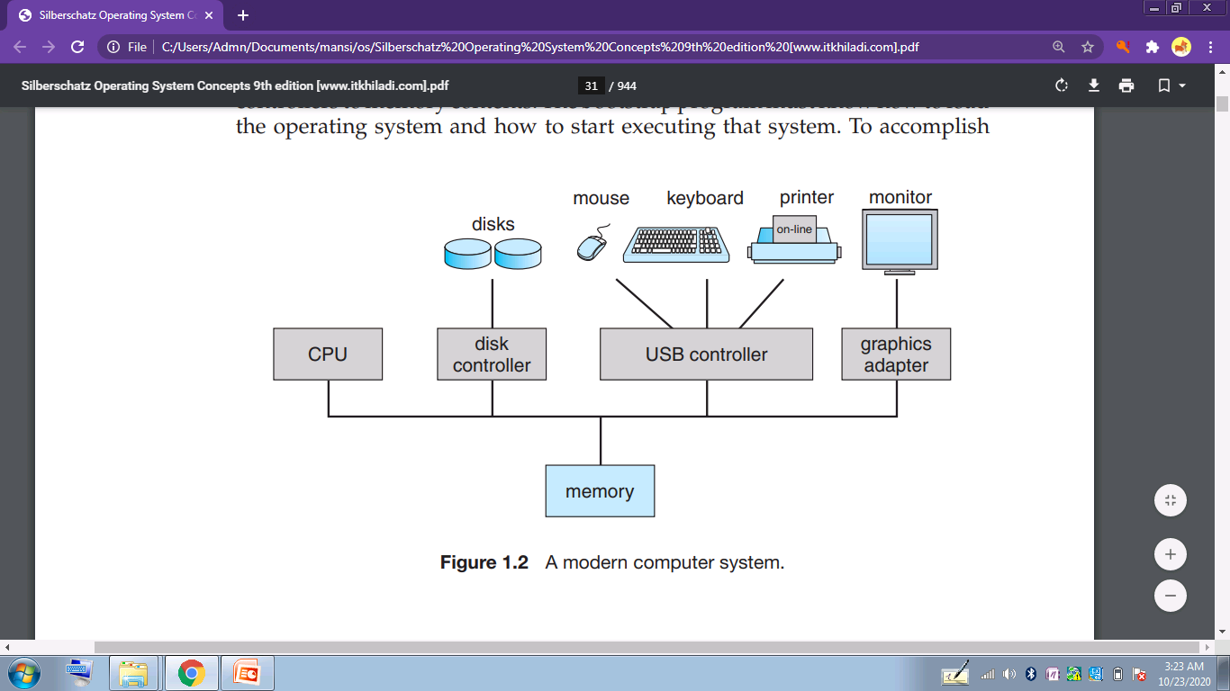

Slide 4
BOOTSTRAP PROGRAM
A bootstrap is the program that initializes the operating system (OS) during startup. A bootstrap program is the first code that is executed when the computer system is started. The entire operating system depends on the bootstrap program to work correctly as it loads the operating system.
The bootstrap program must know how to load the operating system and how to start executing that system. it is stored within the computer hardware in read-only memory (ROM) or electrically erasable programmable read-only memory (EEPROM)
the bootstrap program must locate the operating-system kernel and load it into memory

Slide 5
Once the kernel is loaded and executing, it can start providing services to the system and its users. Some services are provided outside of the kernel, by system programs that are loaded into memory at boot time to become system processes, or system daemons that run the entire time the kernel is running.
On UNIX, the first system process is “init,” and it starts many other daemons. Once this phase is complete, the system is fully booted, and the system waits for some event to occur

Slide 6
INTERRUPT
The occurrence of an event is usually signaled by an interrupt from either the hardware or the software.
An interrupt is a signal to the processor emitted by hardware or software indicating an event that needs immediate attention. Whenever an interrupt occurs, the controller completes the execution of the current instruction and starts the execution of an Interrupt Service Routine (ISR) or Interrupt Handler.

Slide 7
HARDWARE INTERRUPT
A hardware interrupt is an electronic alerting signal sent to the processor from an external device, like a disk controller or an external peripheral. For example, when we press a key on the keyboard or move the mouse, they trigger hardware interrupts which cause the processor to read the keystroke or mouse position.

Slide 8
SOFTWARE INTERRUPT
A software interrupt is caused either by an exceptional condition or a special instruction in the instruction set which causes an interrupt when it is executed by the processor. For example, if the processor's arithmetic logic unit runs a command to divide a number by zero, to cause a divide-by-zero exception, thus causing the computer to abandon the calculation or display an error message. Software interrupt instructions work similar to subroutine calls

Slide 9
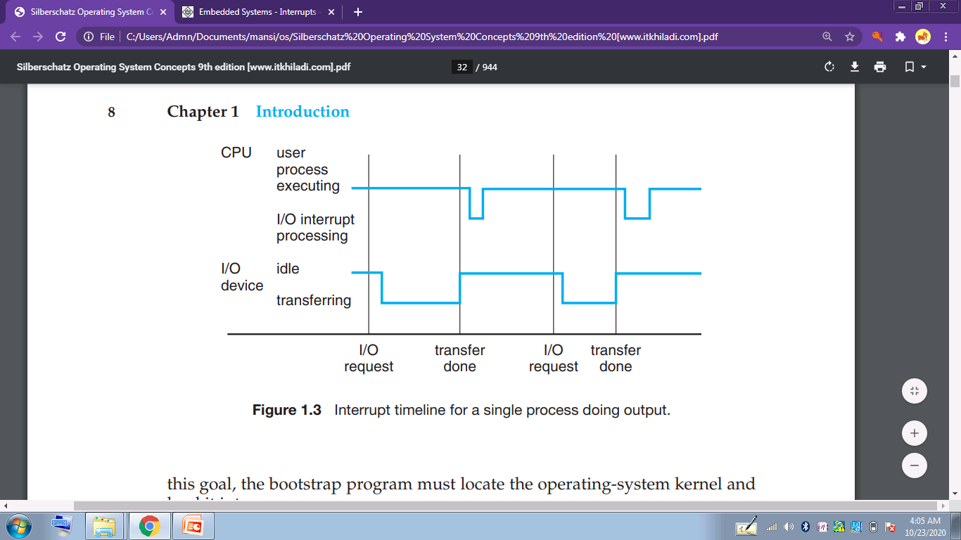

Slide 10
Hardware may trigger an interrupt at any time by sending a signal to the CPU, usually by way of the system bus. Software may trigger an interrupt by executing a special operation called a system call (also called a monitor call).
When the CPU is interrupted, it stops what it is doing and immediately transfers execution to a fixed location. The fixed location usually contains the starting address where the service routine for the interrupt is located.
The interrupt service routine executes; on completion, the CPU resumes the interrupted computation.

Slide 11
INTERRUPT SERVICE ROUTINE (ISR)
For every interrupt, there must be an interrupt service routine (ISR), or interrupt handler. When an interrupt occurs, the microcontroller runs the interrupt service routine. For every interrupt, there is a fixed location in memory that holds the address of its interrupt service routine, ISR. The table of memory locations set aside to hold the addresses of ISRs is called as the Interrupt Vector Table.

Slide 12
STORAGE STRUCTURE
The CPU can load instructions only from memory, so any programs to run must be stored there. General-purpose computers run most of their programs from rewritable memory, called main memory (also called random-access memory, or RAM).
Main memory commonly is implemented in a semiconductor technology called dynamic random-access memory (DRAM).
read-only memory, (ROM) and electrically erasable programmable read-only memory, EEPROM). ROM cannot be changed, only static programs, such as the bootstrap program described earlier, are stored there. The immutability of ROM is of use in game cartridges. EEPROM can be changed but cannot be changed frequently and so contains mostly static programs.

Slide 13
All forms of memory provide an array of bytes. Each byte has its own address.
Interaction is achieved through a sequence of load or store instructions to specific memory addresses. The load instruction moves a byte or word from main memory to an internal register within the CPU, whereas the store instruction moves the content of a register to main memory.
the CPU automatically loads instructions from main memory for execution

Slide 14
BASIC UNIT OF STORAGE
The basic unit of computer storage is the bit. A bit can contain one of two values, 0 and 1
A byte is 8 bits, and on most computers it is the smallest convenient chunk of storage.
word, which is a given computer architecture’s native unit of data. A word is made up of one or more bytes. a computer that has 64-bit registers and 64-bit memory addressing typically has 64-bit (8-byte) words.
A kilobyte, or KB, is 1,024 bytes; a megabyte, or MB, is 1,024 Kilobytes; a gigabyte, or GB, is 1,024 Megabytes; a terabyte, or TB, is 1,024 Gigabytes; and a petabyte, or PB, is 1,024 Terabytes.

Slide 15
A typical instruction–execution cycle, as executed on a system with a von Neumann architecture, first fetches an instruction from memory and stores that instruction in the instruction register.
The instruction is then decoded and may cause operands to be fetched from memory and stored in some internal register.
After the instruction on the operands has been executed, the result may be stored back in memory.
Von Neumann architecture is the design upon which many general purpose computers are based. The key elements of Von Neumann architecture are: data and instructions are both stored as binary . data and instructions are both stored in main memory.

Slide 16
Need of secondary storage :
Main memory is usually too small to store all needed programs and data permanently.
2. Main memory is a volatile storage device that loses its contents when power is turned off or otherwise lost.
Thus, most computer systems provide secondary storage as an extension of main memory. The main requirement for secondary storage is that it be able to hold large quantities of data permanently

Slide 17
Secondary storage
The most common secondary-storage device is a magnetic disk, which provides storage for both programs and data. Most programs (system and application) are stored on a disk until they are loaded into memory. Many programs then use the disk as both the source and the destination of their processing. Hence, the proper management of disk storage is of central importance to a computer system.
registers, main memory, and magnetic disks—is only one of many possible storage systems. Others include cache memory, CD-ROM, magnetic tapes, and so on. Each storage system provides the basic functions of storing a datum and holding that datum until it is retrieved at a later time.

Slide 18
The main differences among the various storage systems lie in speed, cost, size, and volatility.
The higher levels are expensive, but they are fast. As we move down the hierarchy, the cost per bit generally decreases, whereas the access time generally increases.
the various storage systems are either volatile or nonvolatile. volatile storage loses its contents when the power to the device is removed. In the absence of expensive battery and generator backup systems, data must be written to nonvolatile storage for safekeeping
In the hierarchy the storage systems above the solid-state disk are volatile, whereas those including the solid-state disk and below are nonvolatile.

Slide 19
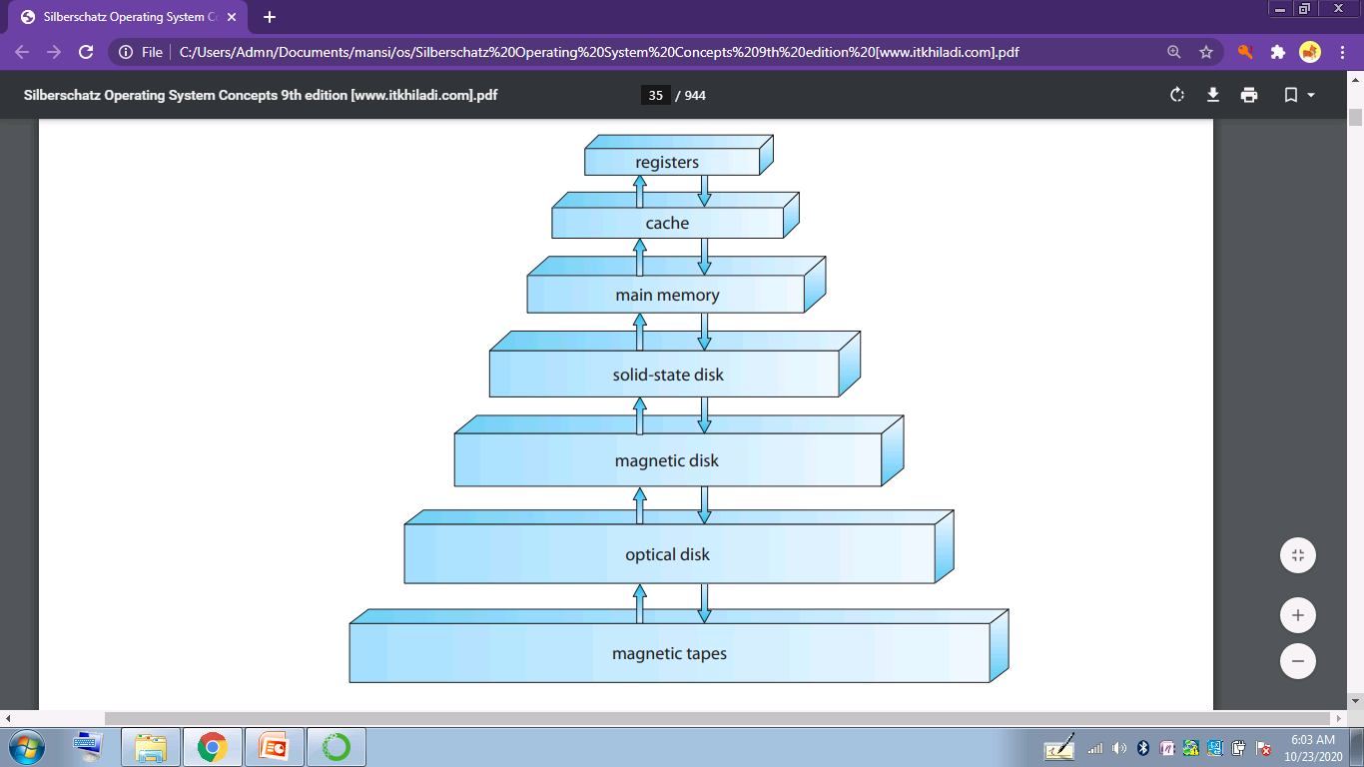

Slide 20
Solid state disk
Solid-state disks have several variants but in general are faster than magnetic disks and are nonvolatile.
One type of solid-state disk stores data in a large DRAM array during normal operation but also contains a hidden magnetic hard disk and a battery for backup power.
If external power is interrupted, this solid-state disk’s controller copies the data from RAM to the magnetic disk. When external power is restored, the controller copies the data back into RAM.
personal digital assistants (PDAs) in robots, flash memory- in camera . These are the other forms of solid state disk

Slide 21
Flash memory is slower than DRAM but needs no power to retain its contents.
Another form of nonvolatile storage is NVRAM, which is DRAM with battery backup power. This memory can be as fast as DRAM and (as long as the battery lasts) is nonvolatile

Slide 22
i/o structure
Storage is only one of many types of I/O devices within a computer. A large portion of operating system code is dedicated to managing I/O, both because of its importance to the reliability and performance of a system and because of the varying nature of the devices.
A general-purpose computer system consists of CPUs and multiple device controllers that are connected through a common bus. Each device controller is in charge of a specific type of device. Depending on the controller, more than one device may be attached.

Slide 23
A device controller maintains some local buffer storage and a set of special-purpose registers. The device controller is responsible for moving the data between the peripheral devices that it controls and its local buffer storage.
operating systems have a device driver for each device controller. This device driver understands the device controller and provides the rest of the operating system with a uniform interface to the device.

Slide 24
To start an I/O operation, the device driver loads the appropriate registers within the device controller.
The device controller, in turn, examines the contents of these registers to determine what action to take (such as “read a character from the keyboard”).
The controller starts the transfer of data from the device to its local buffer. Once the transfer of data is complete, the device controller informs the device driver via an interrupt that it has finished its operation.
The device driver then returns control to the operating system, possibly returning the data or a pointer to the data if the operation was a read. For other operations, the device driver returns status information.

Slide 25
Direct memory access
interrupt-driven I/O is fine for moving small amounts of data but can produce high overhead when used for bulk data movement such as disk I/O.
To solve this problem, direct memory access (DMA) is used. After setting up buffers, pointers, and counters for the I/O device, the device controller transfers an entire block of data directly to or from its own buffer storage to memory, with no intervention by the CPU.
Only one interrupt is generated per block, to tell the device driver that the operation has completed, rather than the one interrupt per byte generated for low-speed devices.
While the device controller is performing these operations, the CPU is available to accomplish other work.

